Slide 1

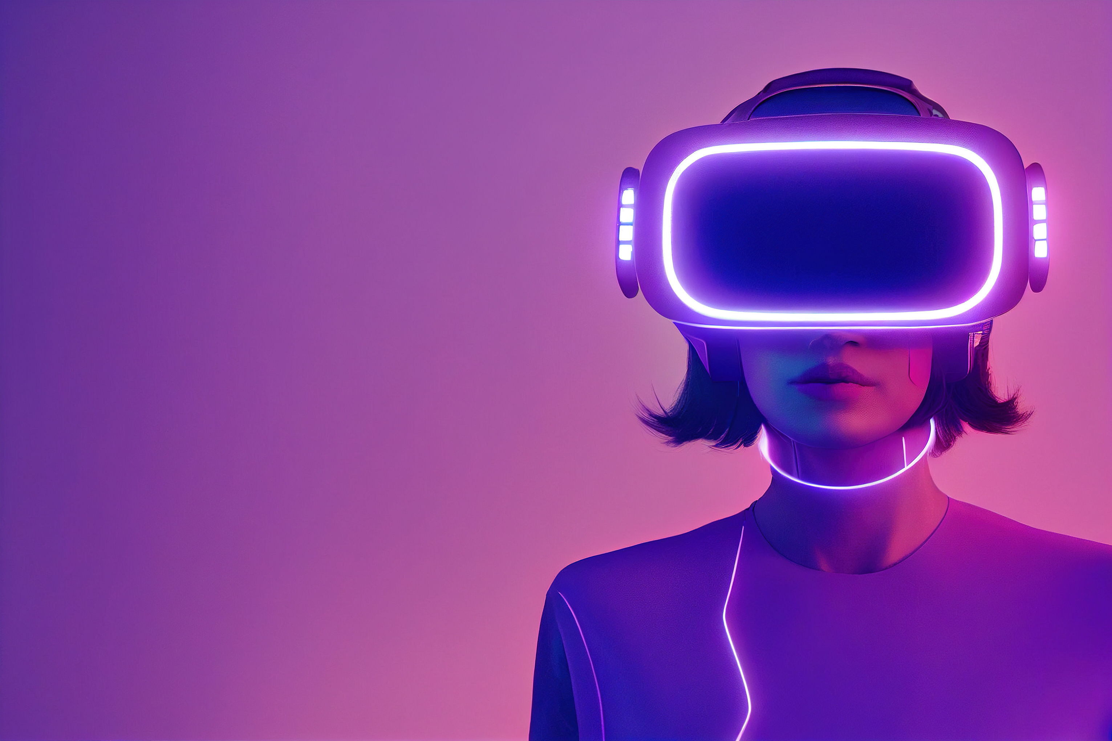
hand gesture
controller
Team CSD

Slide 2

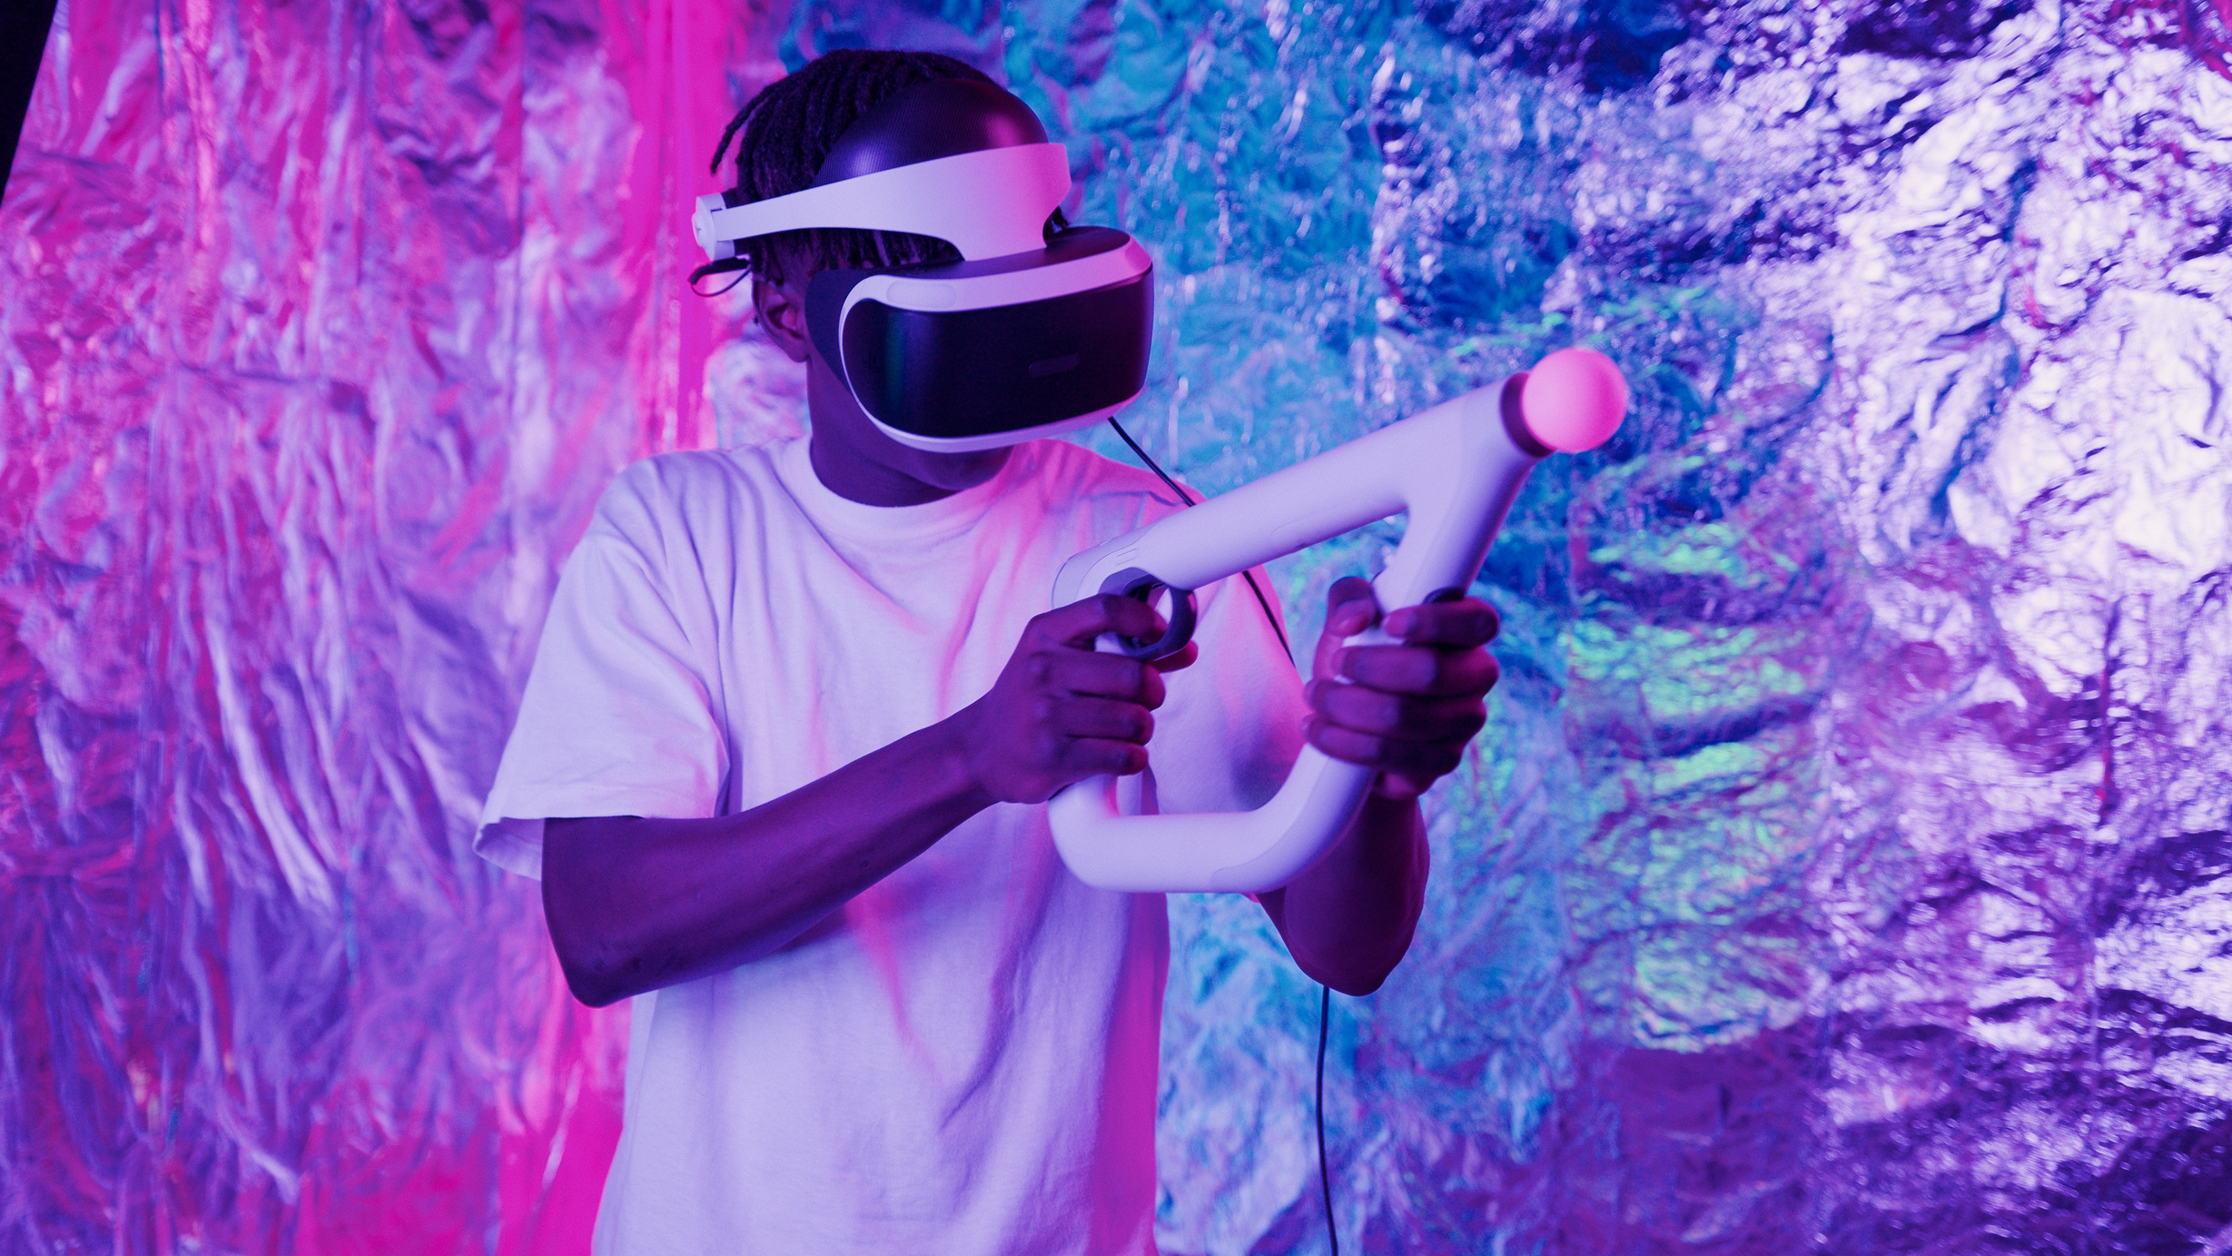

Introduction
About Project
Introducing our Hand Gesture controller! Say goodbye to traditional mouse and keyboard controls. Our project offers an innovative way to interact with your computer using hand gestures captured by a camera. With simple movements, you can navigate through your screen effortlessly: scrolling up and down, selecting items, clicking buttons, adjusting volume and brightness, toggling sound, switching between windows, closing applications etc. Our aim is to provide an intuitive and accessible interface for computer users of all abilities. Experience a new level of convenience and control with our Hand Gesture controller!

Slide 3
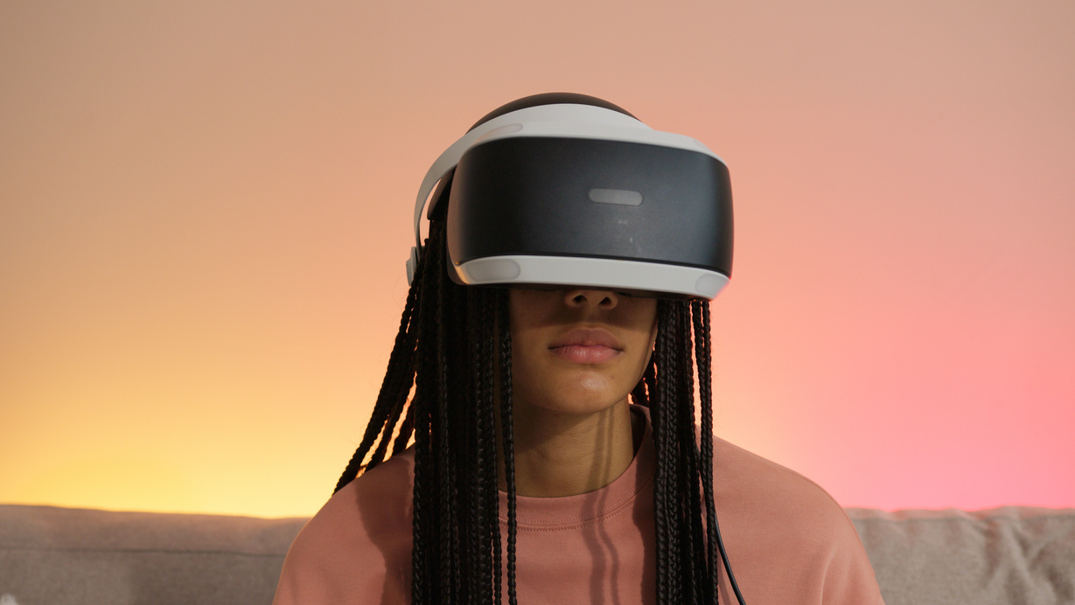
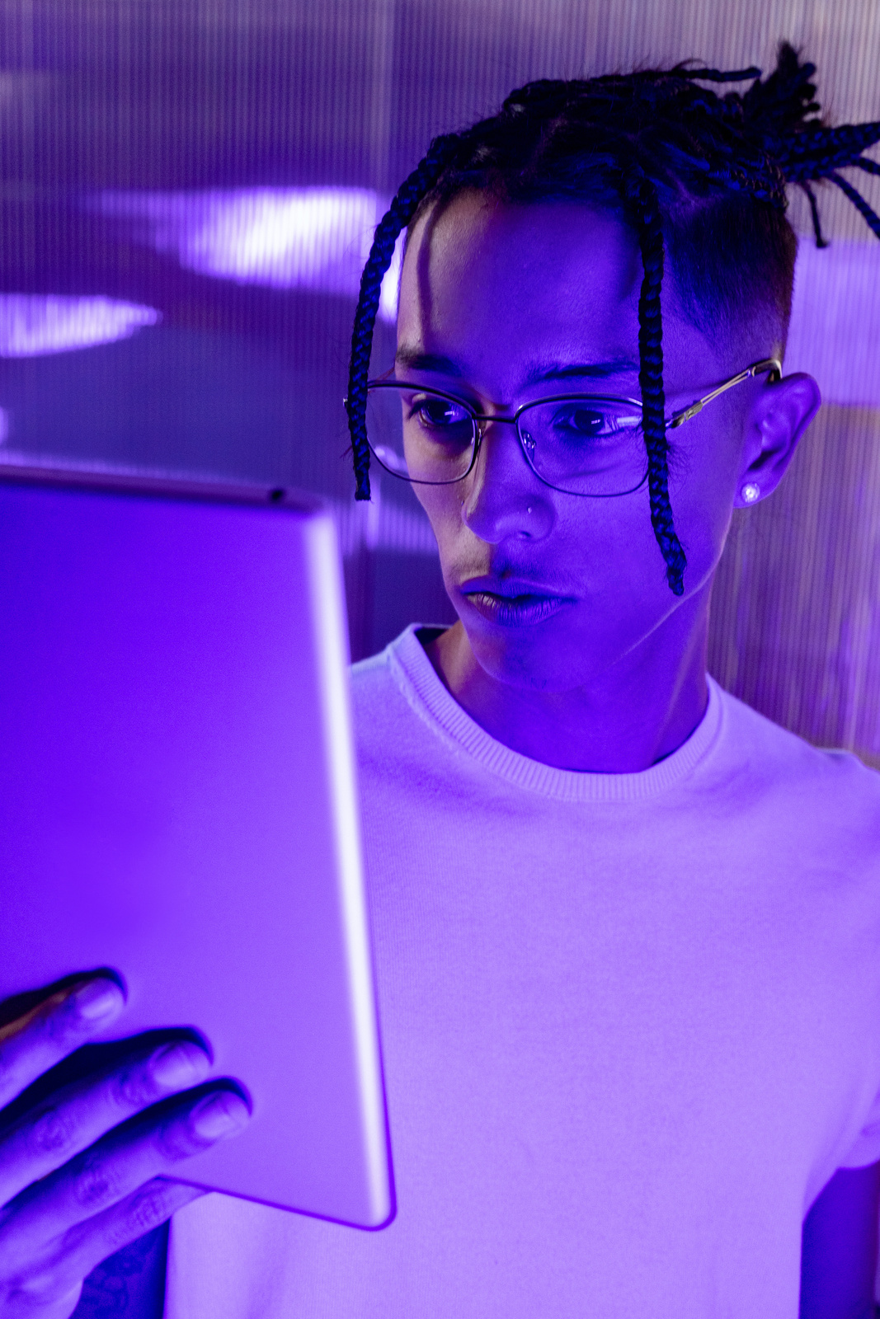
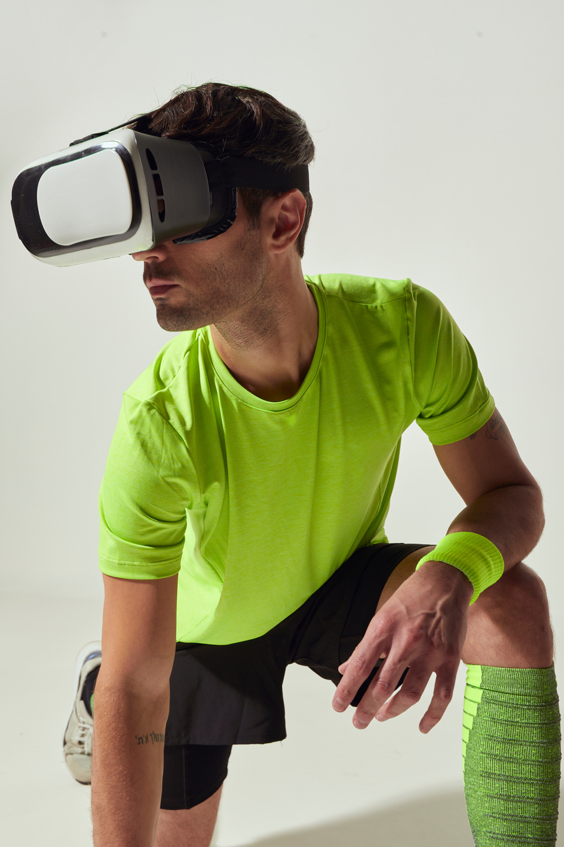

Technoloogies
COMPUTER VISION
PYAUTOGUI
FLASK
MEDIAPIPELINE

Slide 4

Applications
Smart TVs and Media Centers
VR & AR
Education
The virtual mouse could be integrated into VR and AR applications to provide users with hands-free interaction in virtual environments.
Users could control their smart TVs or media centers using hand gestures with the virtual mouse, eliminating the need for a physical remote control.
Teachers and students could use the virtual mouse for interactive learning activities and educational & fostering engagement and collaboration in the classroom.

Slide 5
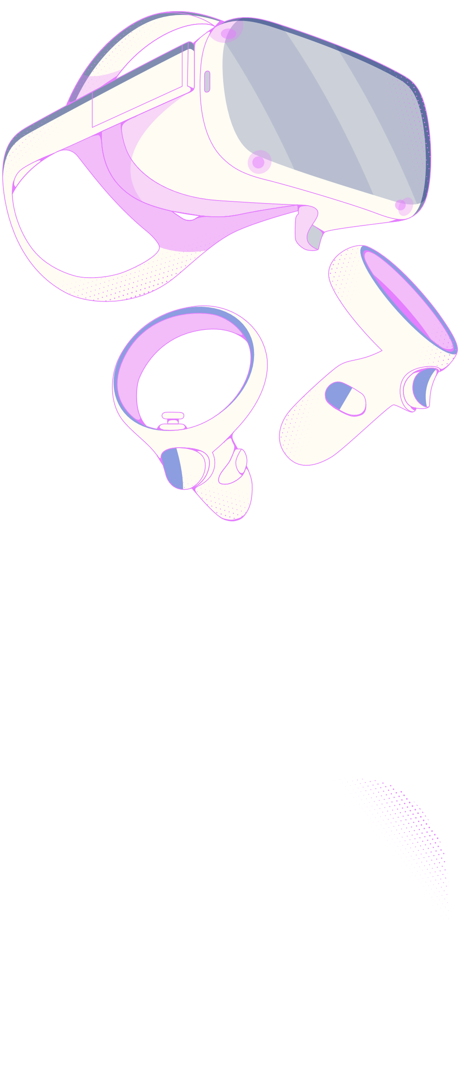
Features
1
5
Infinite
Scroll
Video playback
Controls
2
6
Clicking
Taking
Screenshort
3
7
Volume
Up & down
zoom in/out
4
8
Drag and
Drop
Hold the
Gesture

Slide 6
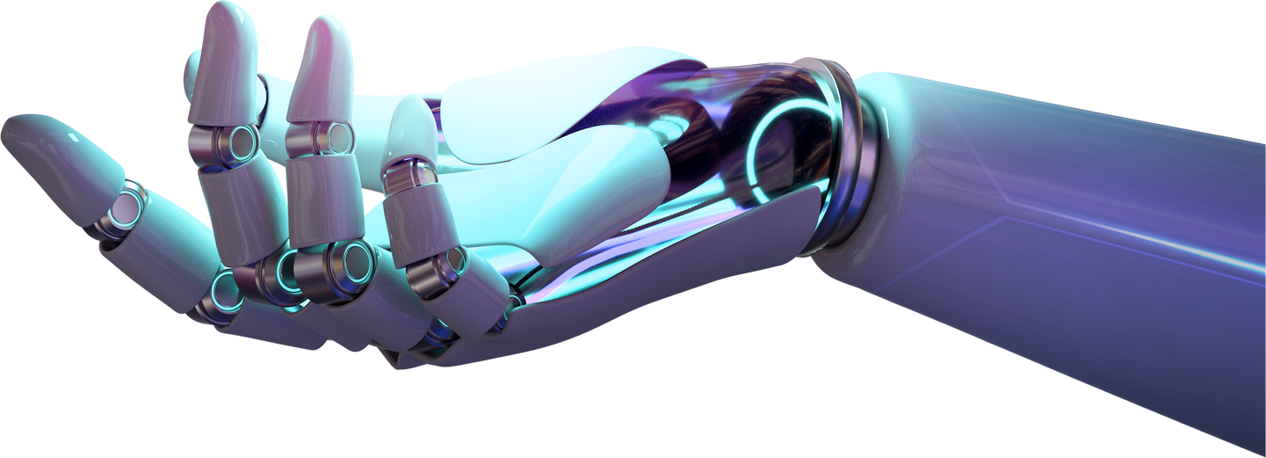
Advantages
Flexibility
Cost-Effectiveness
Enhanced Immersion
Remote Collaboration
Reduced Physical Strain

Slide 7
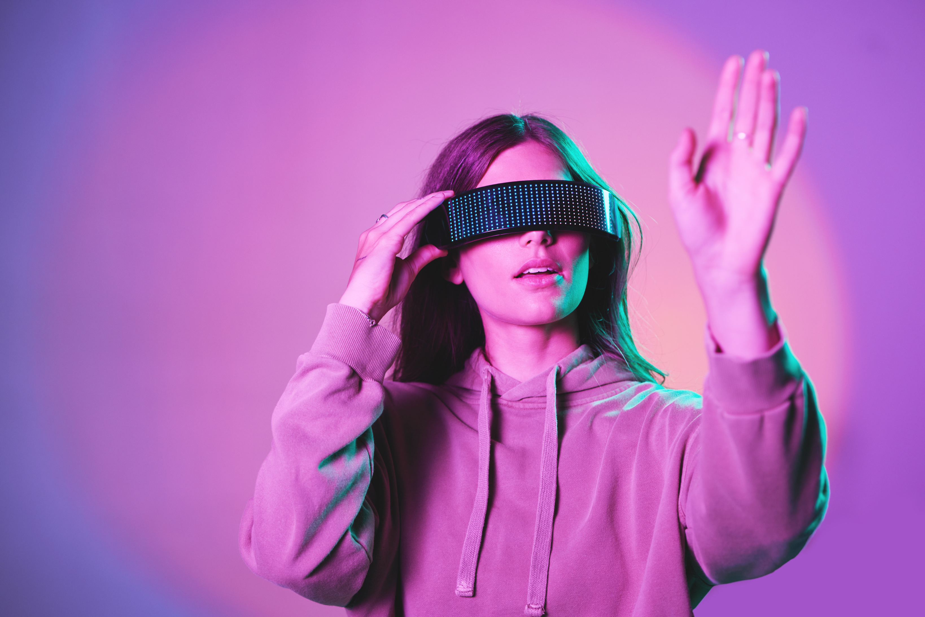
Advancements may include more accurate gesture recognition, integration with natural language interaction, and applications in augmented and mixed reality environments. Additionally, virtual mice could find extensive use in healthcare, s.mart homes, and remote work settings, enhancing accessibility, efficiency.
future scope
100%
However, privacy and security concerns will need careful regulation.

Slide 8
Conclusion
The future of Hand gesture controller holds immense promise. Advancements in gesture recognition, natural language interaction, and augmented reality integration will revolutionize computer interaction. From healthcare to education and remote work, virtual mice offer innovative solutions for accessibility and collaboration. However, addressing privacy and security concerns is crucial. Overall, virtual mouse technology represents a significant step forward in human-computer interaction, shaping transformative experiences in our digital age.

Slide 9

demonstration...

Slide 10
Thank
you!

